Slide 1
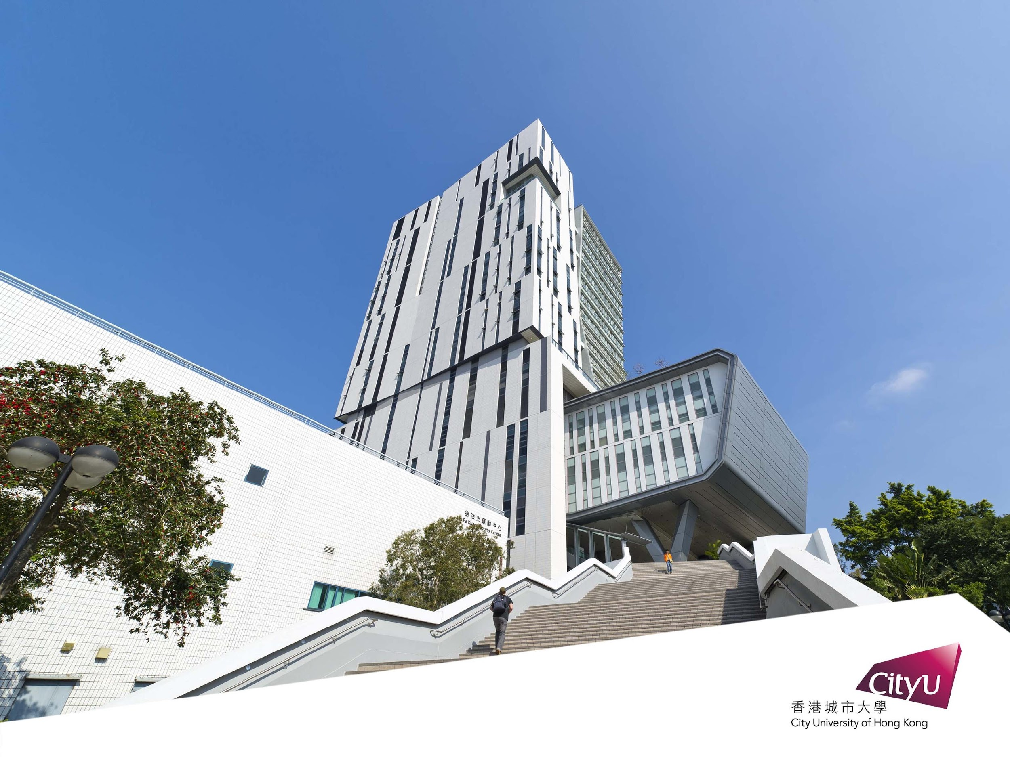
An Analysis of Convolutional Neural Network
Lan Yiyuan:55614744
Sun Jingyao: 55880040
Zou Shuang: 55911609
Li Yixin：55975771
Du Kejun: 56075096

Slide 2

Agenda
Introduction
The Introduction of Dataset
AlexNet
VGG
ResNet
Evaluation
Conclusion

Slide 3
1. Introduction
Convolutional neural network (CNN) is an artificial neural network based on human visual cognitive model. Through its hierarchical feature extraction method, users can obtain the features of various layers from the low level to the high level. CNN is the foundation of deep learning, it plays an important role especially in the field of computer vision, such as image classification, object detection, instance segmentation and scene capture.
We choose three classic CNN model in this project and let each of them trained two dataset to make a comparison. The model we choose is AlexNet, VGG16 and ResNet.

Slide 4
2. The Introduction of Dataset
MNIST Datase
MNIST Dataset is a classic data set in the field of machine learning.
The MNIST dataset consists of 60,000 training samples and 10,000 test samples, each of which is a 28×28 pixel grayscale handwritten digital images. These handwritten digitals have been dimensioned and be located in the center of the image.

Slide 5
2. The Introduction of Dataset
B. CIFAR-10 Dataset
CIFAR-10 is a widely used data set which are labeled subsets of 80 million tiny images dataset. It consists 50000 training images and 10000 test images.
CIFAR-10 samples contains objects in the real world. This means that the noisy of data set would be larger, and the objects have different proportions and features, which makes it difficult to identify them.

Slide 6
3. AlexNet
AlexNet deepens the network structure and learns richer and higher-dimensional image features on the basis of LeNet.
We select AlexNet for this project, because it is the most widely researched CNN and is a proper trade-off between speed and accuracy.
The model was trained on approximately 1.2 million training pictures and performed testing on 150,000 ImageNet data sets test pictures.
This model is very efficient for reducing the overfitting problem with the help of maintaining dropout and data augmentation.

Slide 7
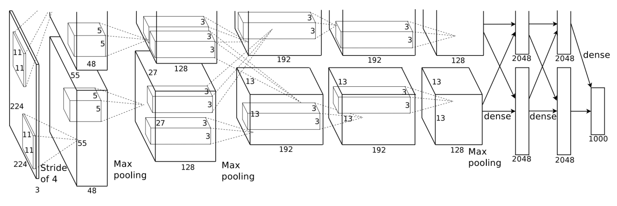
3. AlexNet
Convolution Neural Network
The model comprises of 3 fully connected layers and 5 convolutional layers.
The first layer of AlexNet is used for input of a filtered image with a dimension of 227 × 227 × 3 respectively for width, height, and depth (red, green, blue).
The last fully connected layer connects 1000 connected layers and the rest of the layers’ work as a feature extractor.

Slide 8
3. AlexNet
Convolution Neural Network
For each input image, AlexNet can produce a 4096-dimensional feature vector that includes the hidden layer activations instantly before the output layer.
AlexNet itself is a huge structure containing 650,000 neurons and 60 million parameters.

Slide 9
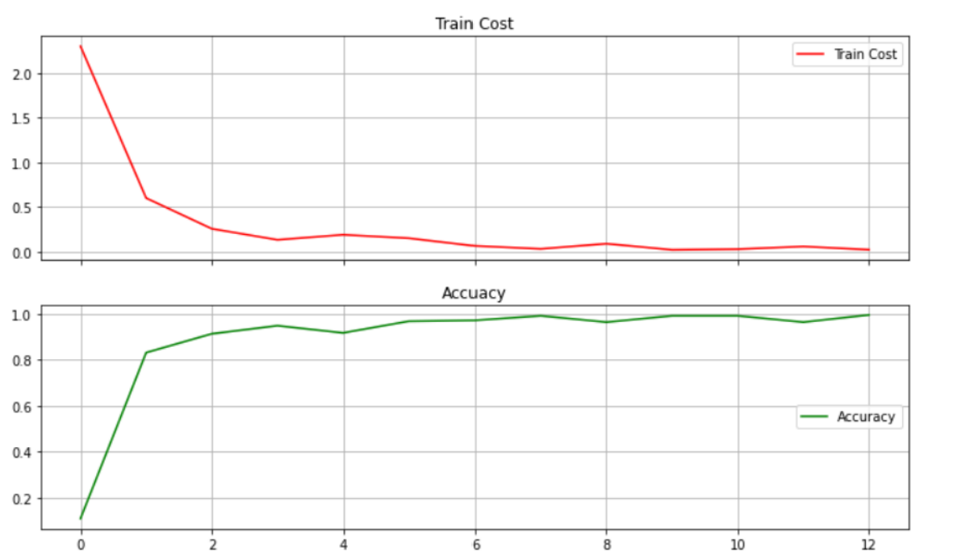
3. AlexNet
Result in Dataset MNIST

Slide 10
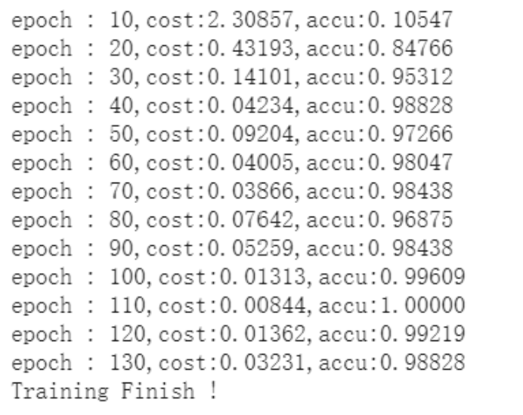
3. AlexNet
Result in Dataset MNIST

Slide 11
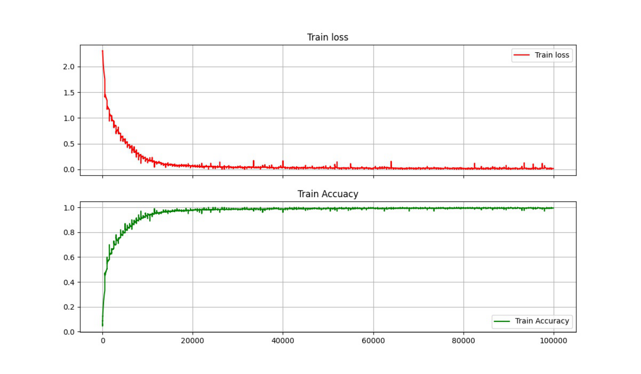
3. AlexNet
Result in Dataset CIFAR-10

Slide 12
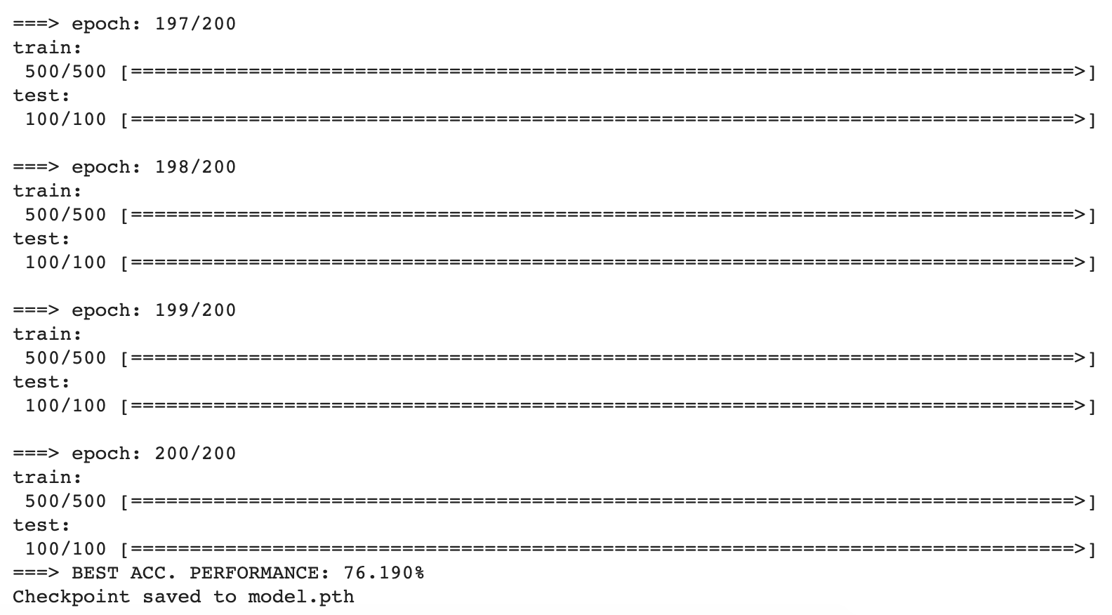
3. AlexNet
Result in Dataset CIFAR-10

Slide 13
4. VGG
VGGNet divides the network into 5 segments, each segment connects multiple 3 × 3 convolutional networks in series, each segment is followed by a maximum pooling layer, and finally there are 3 fully connected layers and a softmax layer.
VGGNet all uses 3 × 3 convolution kernels and 2 × 2 pooling kernels to improve performance by continuously deepening the network structure. The increase in the number of network layers will not bring about an explosion in the amount of parameters, because the amount of parameters is mainly concentrated in the last three fully connected layers.

Slide 14
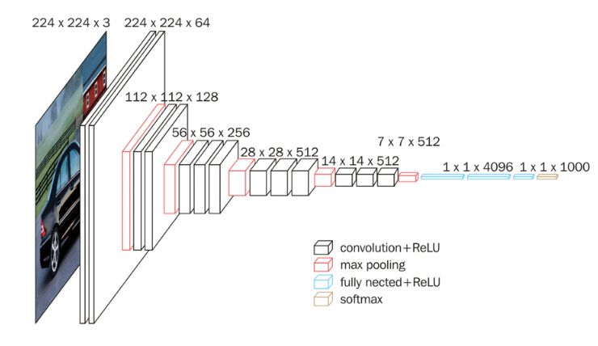
4. VGG
The outstanding feature of VGG16 is simplicity, which is reflected in: 1. The convolutional layers all use the same convolution kernel parameters. 2. The pooling layer adopts the same pooling nuclear parameters. 3. The model is composed of a stack of convolutional layers and pooling layers, and it is relatively easy to form a deep network structure. Based on the above analysis, the advantages of VGG can be summarized as: Small filters, Deeper networks.

Slide 15
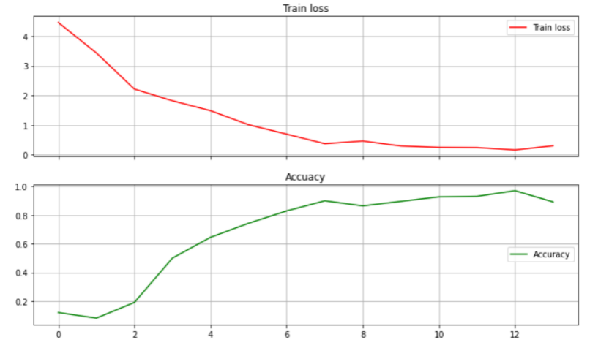
4. VGG
Result in Dataset MNIST

Slide 16
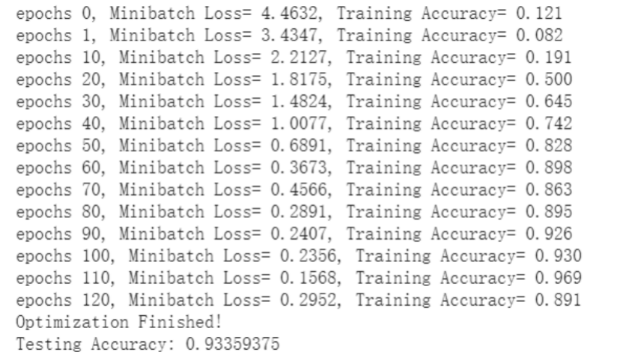
4. VGG
Result in Dataset MNIST

Slide 17
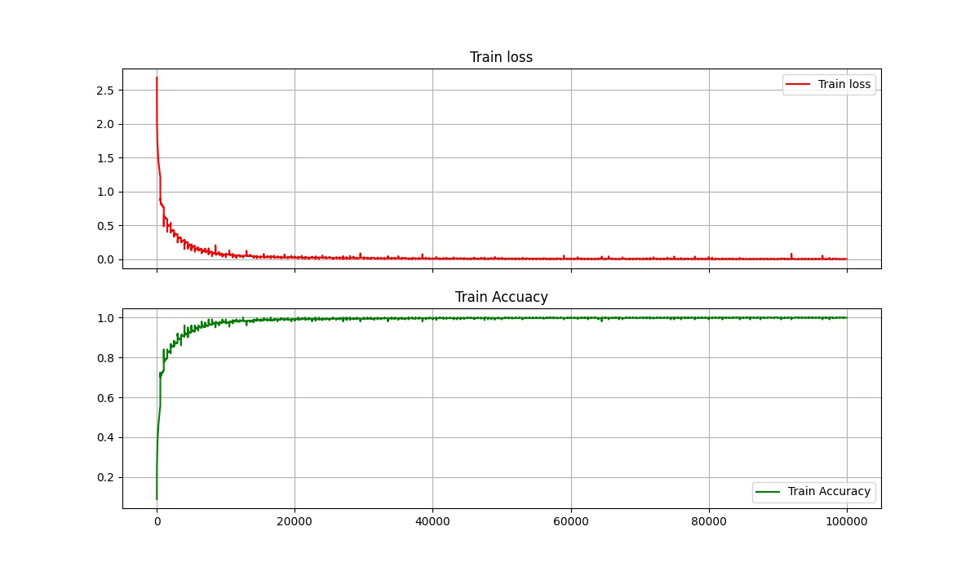
4. VGG
Result in Dataset CIFAR-10

Slide 18
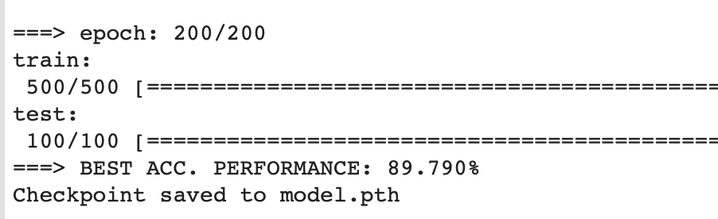
4. VGG
Result in Dataset CIFAR-10

Slide 19
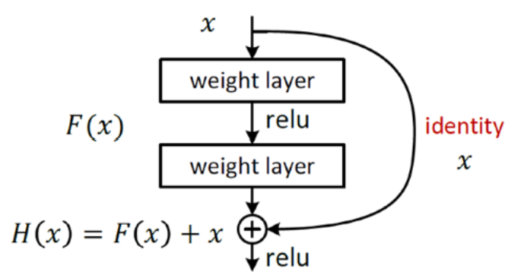
5. ResNet
Residual Network
The ResNet referred to the VGG19
ResNet also added residual unit through the short circuit mechanism
The changes between VGG and ResNet are mainly reflected in the fact that ResNet directly uses the convolution of stride=2 to sample and replaces the full connection layer with the global average pool layer.
An important design principle of ResNet is that when the feature map size is reduced by half, the number of feature maps is doubled, which keeps the complexity of the network layer.

Slide 20
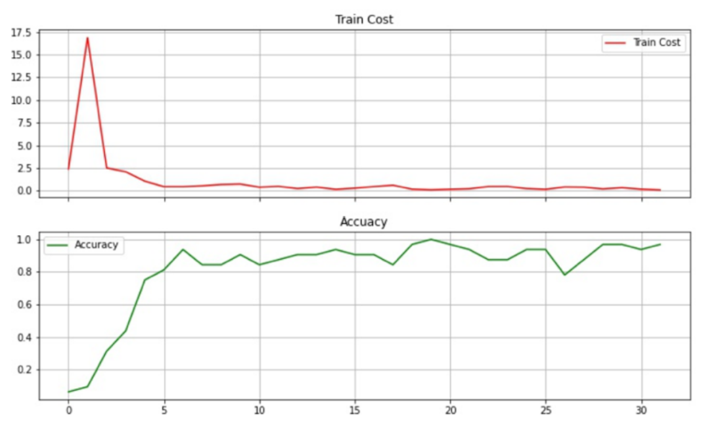
5. ResNet
Result in Dataset MNIST

Slide 21
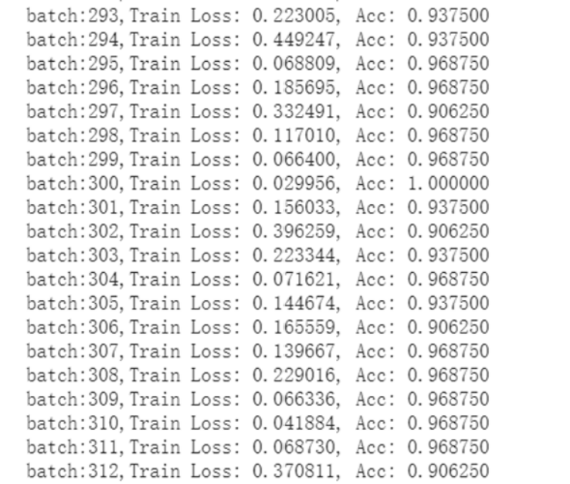
5. ResNet
Result in Dataset MNIST

Slide 22
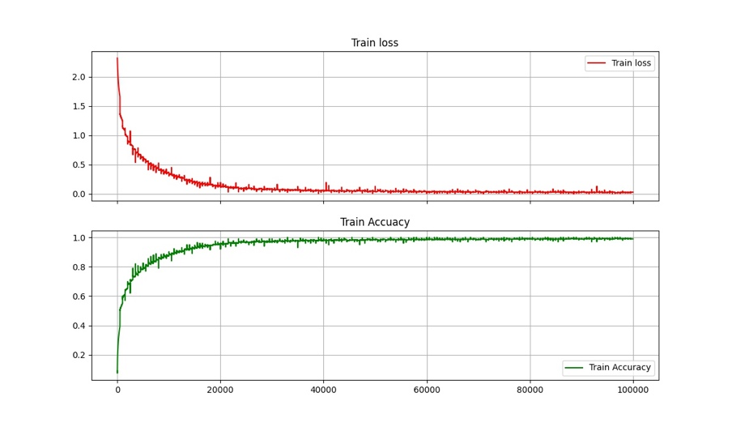
5. ResNet
Result in Dataset CIFAR-10

Slide 23
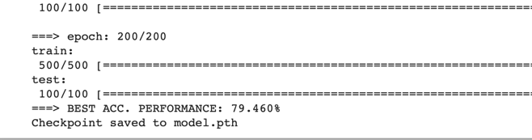
5. ResNet
Result in Dataset CIFAR-10

Slide 24
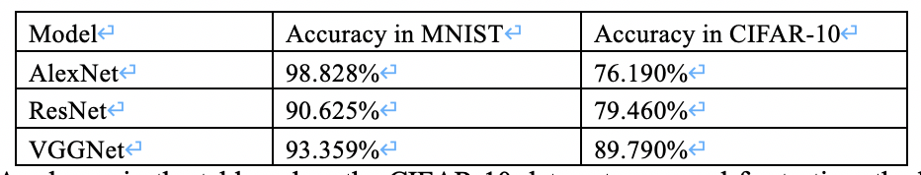
6. Evaluation
When the CIFAR-10 data set was used for testing, the best accuracy performance of VGGNet was the highest, reaching 89.790%. The highest accuracy demonstrates VGG-16 has better classification ability and eliminating unrelated information.
VGG-16 makes improvement at the expense of longer training time. The possible reason for this result might be that AlexNet retains more irrelevant information in the final convolutional layer than VGG-16, which interferes with the final prediction. In addition, the overmuch layers in ResNet lead to functional complexity, which result in over-fitting problems and ultimately accuracy reduction.

Slide 25
7. Conclusion
The aim of this work was to use Colab to train and evaluate the performances of three CNN models (AlexNet, ResNet and VGG16) to identify which one has better accuracy in classification and identification.
From this work, we conclude that VGG-16 by far presents the best accuracy rate, as compared to the AlexNet and ResNet. Moreover, the train accuracy and the number of epoch maybe affected by the size of data set. Based on this result, VGG-16 should be the best choice to do the image classification and identification.

Slide 26
References
[1] Fazla Rabbi Mashrur, Amit Dutta Roy, Dabasish Kumar Saha, “Automatic Identification of Arrhythmia from ECG Using AlexNet Convolutional Neural Network”, 2019 4th International Conference on Electrical Information and Communication Technology (EICT), 20-22 Dec. 2019.
[2] A. Krizhevsky, I. Sutskever, G. E. Hinton, “ImageNet Classification with Deep Convolutional Neural Networks”, International Conference on Neural Information Processing Systems, vol. 2, pp. 1097-1105, 2012.
[3] S. Gu, L. Ding, Y. Yang, X. Chen, “A new deep learning method based on AlexNet model and SSD model for tennis ball recognition”, 2017 IEEE 10th International Workshop on Computational Intelligence and Applications (IWCIA), 11-12 Nov. 2017.
[4] Hussam Qassim, Abhishek Verma, David Feinzimer. Compressed residual-VGG16 CNN model for big data places image recognition[C]// IEEE Computing & Communication Workshop & Conference. IEEE, 2018.
[5] He, Kaiming, et al. “Deep residual learning for image recognition.” Proceedings of the IEEE conference on computer vision and pattern recognition. 2016.
[6] Zhang, Yue, "Evaluation of CNN Models with Fashion MNIST Data" (2019). Creative Components. 364.
[7] https://github.com/icpm/pytorch-cifar10.git
[8] https://blog.csdn.net/u014281392/article/details/74938524
[9] https://blog.csdn.net/qq_39751437/article/details/97366544
[10] https://blog.csdn.net/xun__Meng/article/details/89194148

Slide 27

Thank you!

